Slide 1
Semantic Segmentation Deeplab v3+

Slide 2
Semantic Segmentation
Classifying all pixels in an image into classes.
Classification at pixel level.
Partitioning of Image into meaningful objects and assigning category labels.

Slide 3
Disadvantages For Semantic Segmentation
Down-sampling causes loss of information.
The invariance in the input images harms the accuracy.
DeepLab address those issues by:
Dilated convolution
CRFs (Conditional Random Fields).

Slide 4
Background
Deeplab v3+ is the latest of the deeplab models
Deeplab v1: Semantic Image Segmentation with Deep Convolution Nets and fully connected CRFs (conditional random fields).
DeepLab v2: Semantic segmentation with Deep Convolution Nets, Atrous Convolution and fully connected CRFs.
DeepLab v3: Rethinking Atrous/Dilated Convolution for semantic segmentation.
DeepLab v3+: Encoder – Decoder with Atrous/Dilated Convolution for Semantic Image Segmentation.

Slide 5
Dilated Convolution
Advantages:
Larger receptive Field
Lesser memory consumption
Computationally effective

Slide 6
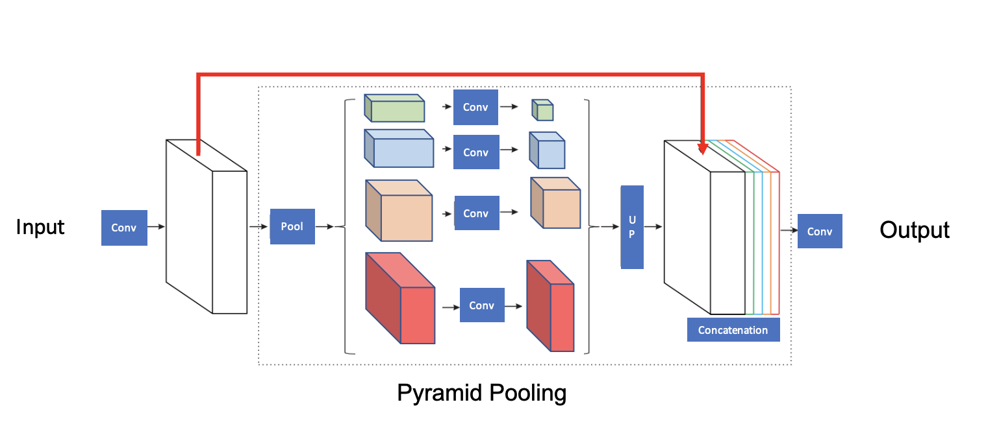
Pyramid Pooling

Slide 7
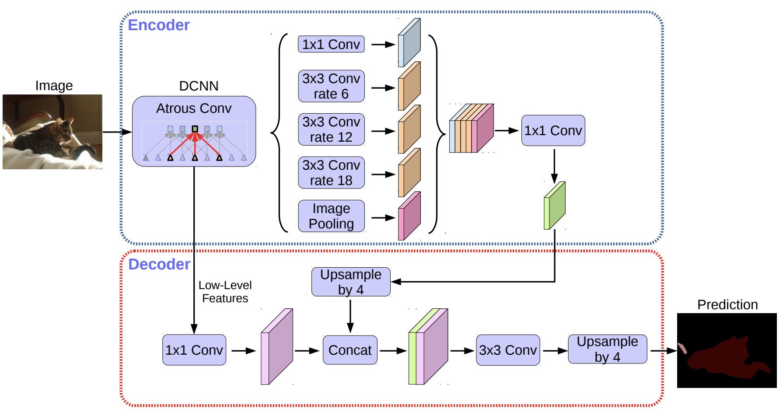

Slide 8
Encoder
Dilated Spatial Pyramid Pooling (DSPP):
Average Pooling (on input image)
1 x 1 Convolution
3 x 3 Convolution, Dilation rate = 6
3 x 3 Convolution, Dilation rate = 12
3 x 3 Convolution, Dilation rate = 18
Concatenate all layers
1 x 1 Convolution on the concatenated layer

Slide 9
Decoder
1 x 1 Conv layer is Up sampled by 4 times
Low level features are extracted from DCNN
Both the above layers are concatenated
Then up sampling again 4 times
Predicted Output (512 x 512 x1)

Slide 10
Modifications
Implemented AdamW optimizer for Adam
Epochs changed from 25 to 28
Activation function – used Leaky Relu
Batch size changed from 4 to 8

Slide 11
Leaky ReLU, has a small slope for negative values instead of a flat slope. Slope coefficient is determined before training
AdamW optimizer is implemented to lower the chance of overfitting. With AdamW has an improved implementation of weight decay.
Batch size is changed from 4 to 8. (for faster training times)
Bilinear Interpolation takes 2 x 2 pixels into account

Slide 12
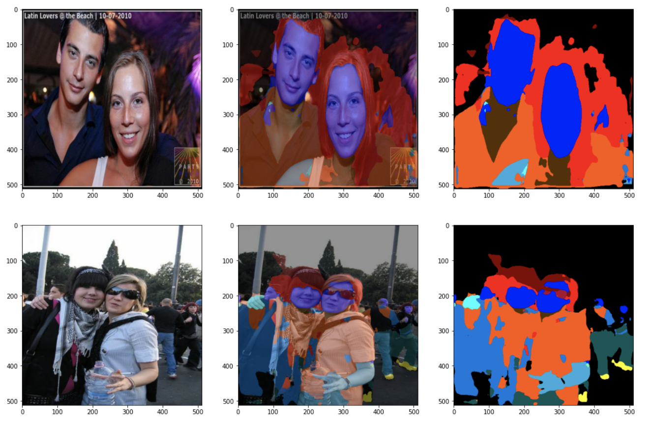
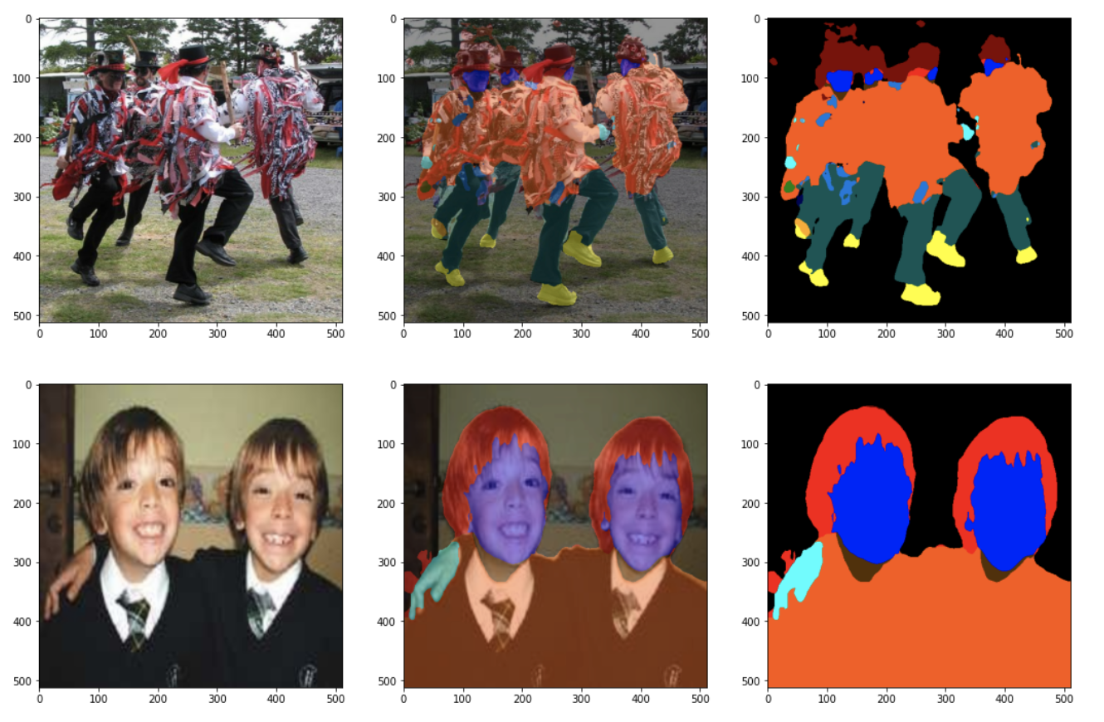
Original outputs
Accuracy: 93.77 for 25 epochs

Slide 13
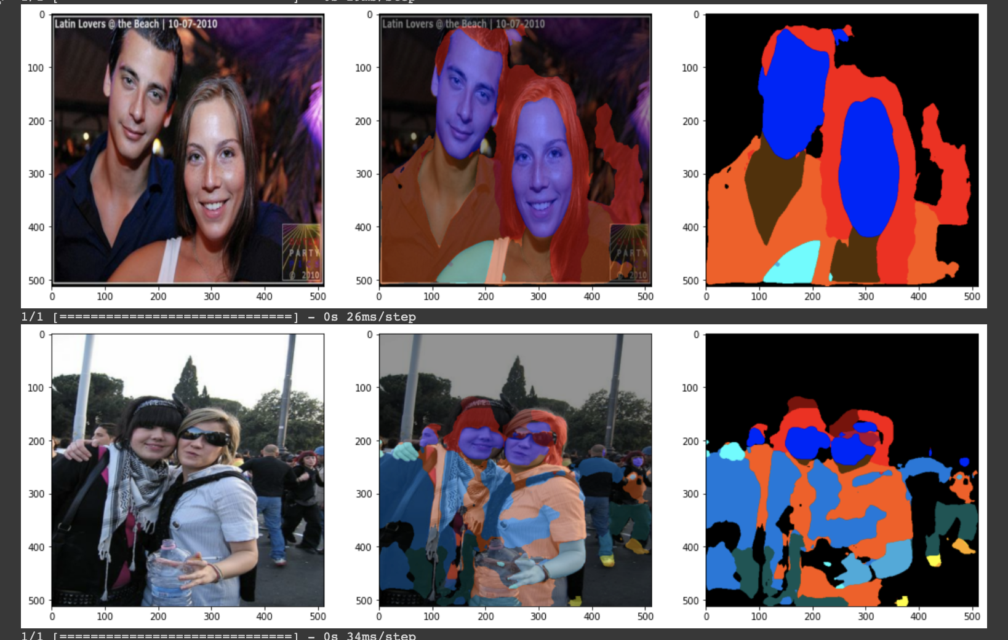
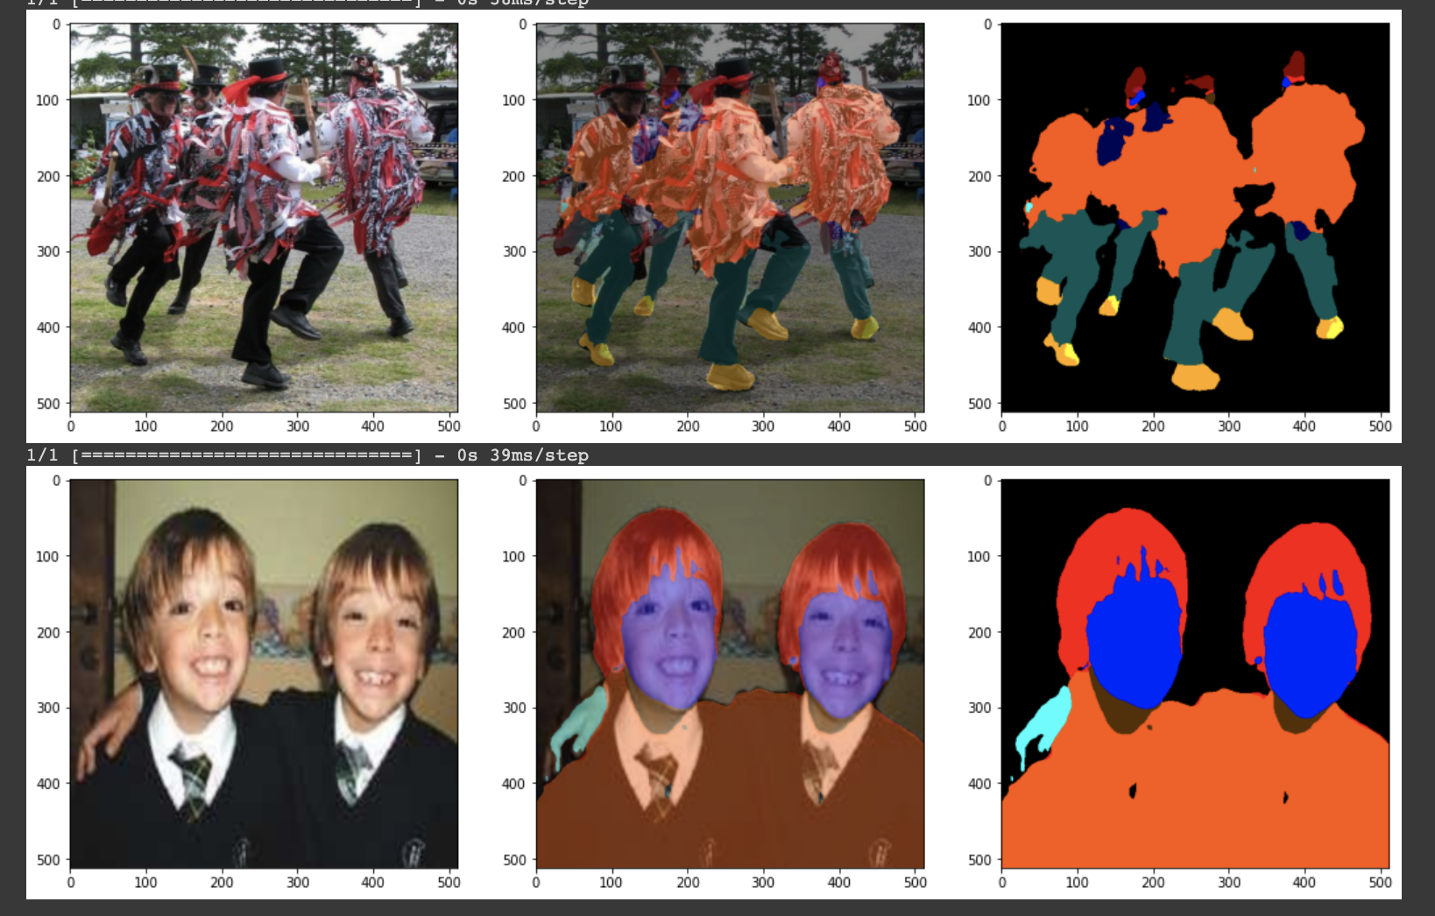
Epochs = 20
Accuracy: 92.24%

Slide 14
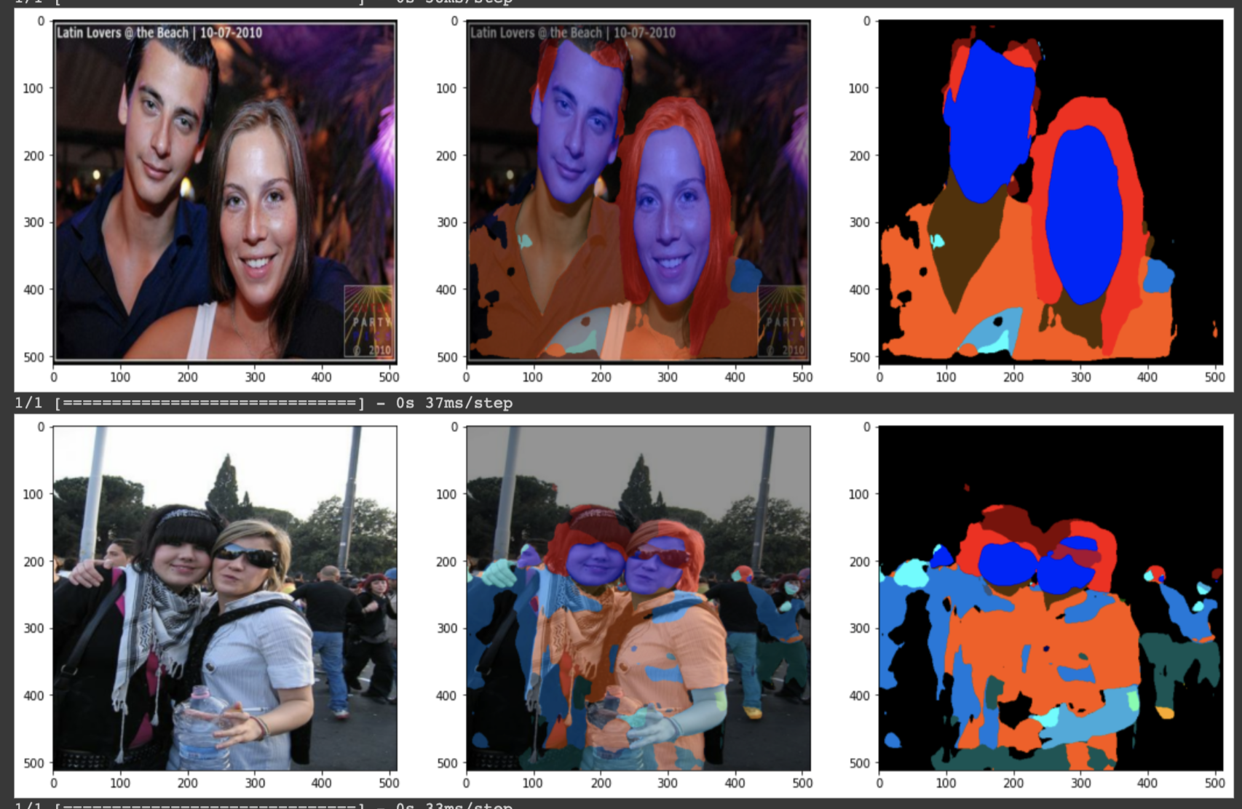
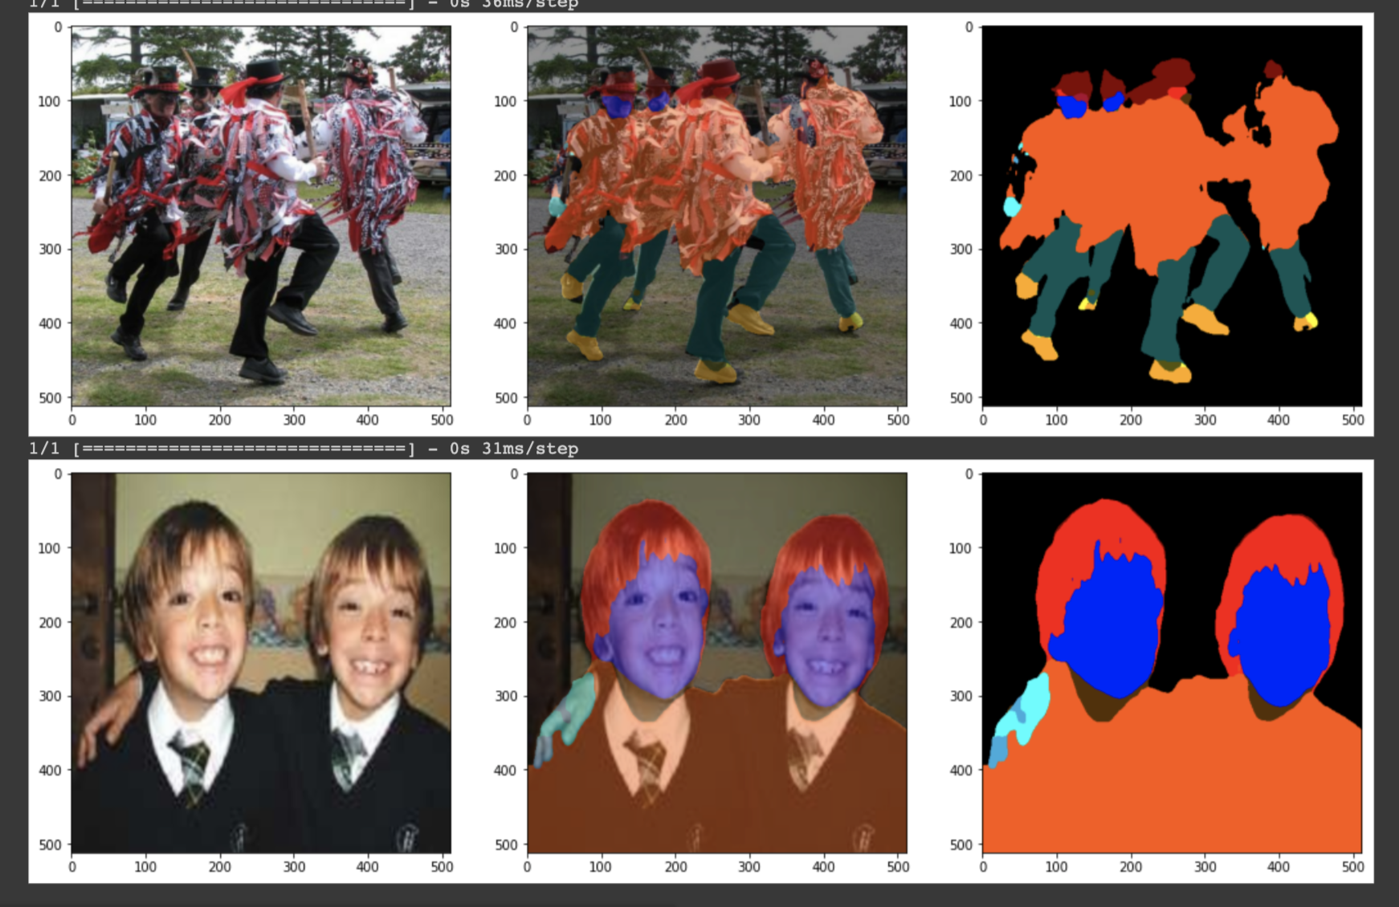
Final Outputs
Accuracy = 94.16% epochs = 28

Slide 15
Original Accuracy (25 epochs) – 93.77
Achieve Accuracy 25 epochs – 93.73
Achieved Accuracy 28 epochs – 94.16

